Slide 1

bSlight: Battery-Less Energy Autonomous Street Light Management System for Smart City
UNIVERSITY OF NORTH TEXAS
DEPARTMENT OF COMPUTER SCINCE AND ENGINEERING
By
NAME:SRINU PERUMALLA
ID:11750704
Department of Computer Science & Engg
University Of North Texas
Instructor:
Prof.Dr.Saraju P Mohanty
Department of Computer Science & Engg
University Of North Texas

Slide 2
Contents:
Abstract
Introduction
Proposed model
Components
Challenges
Advantages & dis-advantages
Conclusion and Future scope
References

Slide 3
Abstract
The bSlight system is a battery-less energy autonomous street light management system designed for smart cities, utilizing supercapacitors for energy storage and solar cells for energy harvesting.
The proposed system architecture includes a Power Management Unit responsible for energy optimization, a Sensor Node for sensing and communication tasks, a LoRaWAN Gateway for cloud communication, and Cloud Server for data storage and analytics.
Key features of the system include duty cycle optimization, efficient power management, real-time monitoring through a Graphical User Interface (GUI), and the ability to adjust street light illuminance based on environmental conditions like movement detection and light intensity.

Slide 4
Introduction
The bSlight system is a groundbreaking battery-less energy autonomous street light management system designed for smart cities.It offers a sustainable solution for smart cities by eliminating the need for batteries or grid power, reducing energy consumption, minimizing environmental impact, bSlight provides a cost-effective solution for managing street lights in smart cities, enhancing overall urban infrastructure.
It operates in real-time and embodies self-sustainability within the green IoT paradigm. This innovative system is the first of its kind, utilizing a supercapacitor for energy storage and enabling energy harvesting regardless of time, even during nighttime when energy availability is critical.

Slide 5
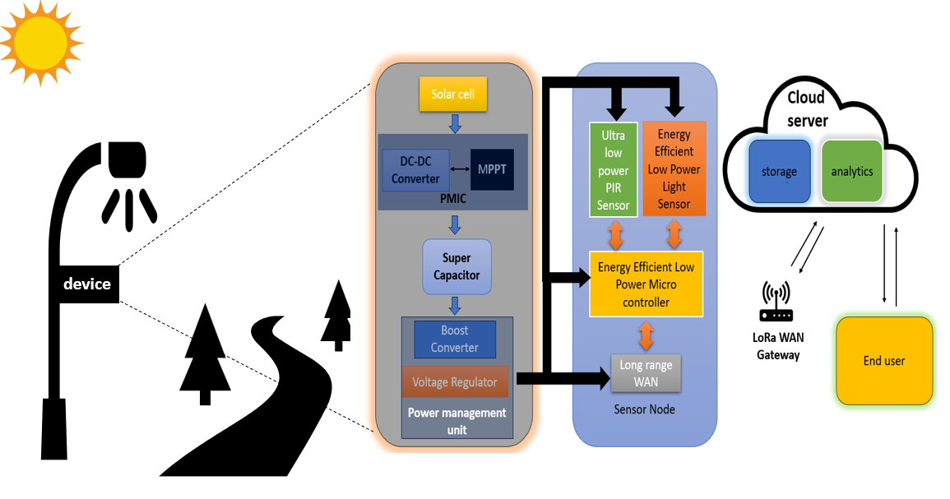
Proposed Model:

Slide 6
Working
Power Management Unit (PMU):
Responsible for harnessing, optimizing, storing, and regulating energy.
Includes solar cells for energy harvesting and a PMIC with MPPT for power optimization.
Regulates energy flow to a supercapacitor for storage,perform MPPT calculation and ensures monitoring of overcharge and minimum voltage levels.
Boost converter is used to convert the output of super capacitor to 3.3V
Sensor Node:
Performs sensing, processing, and communication tasks.
Includes a microcontroller, sensors (e.g., Passive Infrared, light sensors), and a LoRa module.
Microcontroller processes sensor signals, controls street light dimming, and communicates status to the LoRaWAN gateway.
Uses low-power components for efficient operation.

Slide 7
LoRaWAN Gateway:
Acts as an intermediary between sensor node and cloud server.
Receives data from sensor node via MQTT broker and transmits it to the cloud server.
Employs symmetric encryption for secure data transmission using LoRa technology.
Uses MQTT protocol for low-power consumption, quick data transfer, and lightweight design, suitable for IoT applications.
Cloud server &End user:
The Cloud Server stores data received from the sensor node and consists of cloud storage and analytics units, providing valuable insights to the end user for real-time monitoring.
End users can access data through a visually appealing Graphical User Interface (GUI) via mobile applications or web portals, enabling remote monitoring of street light operations based on the information received from the sensor node.

Slide 8
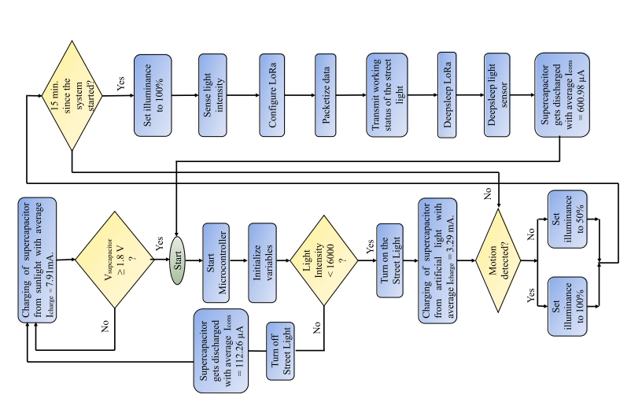
FLOW CHART
Source :https://ieeexplore.ieee.org/stamp/stamp.jsp?tp=&arnumber=10236570

Slide 9
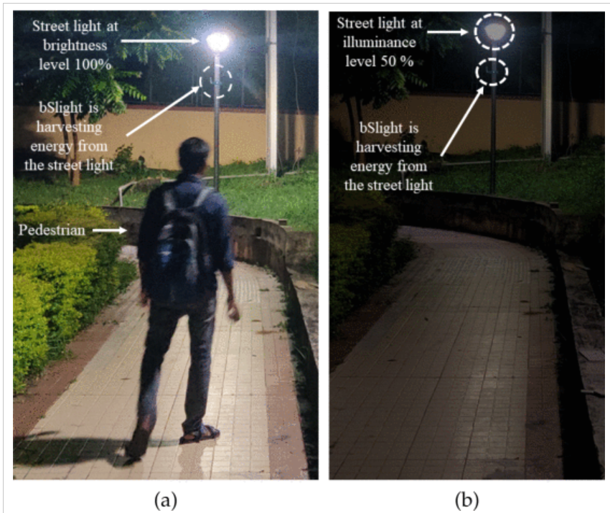
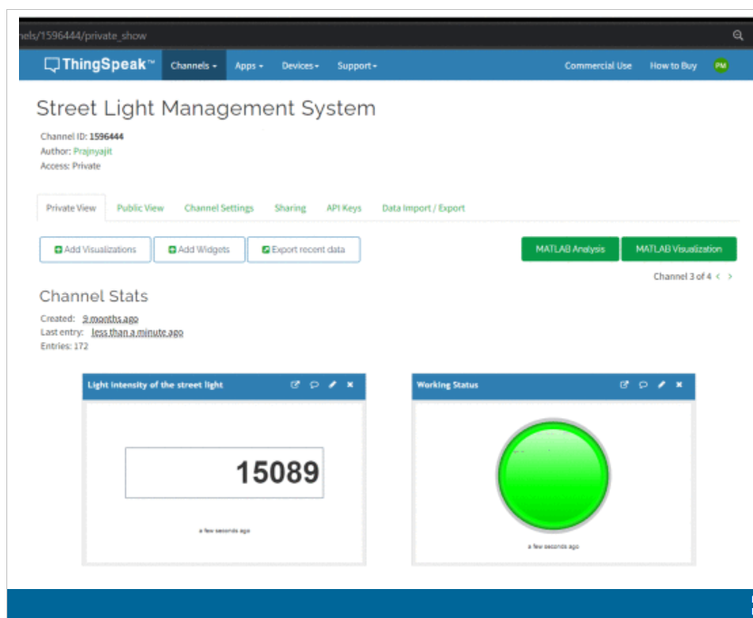
Source :https://ieeexplore.ieee.org/stamp/stamp.jsp?tp=&arnumber=10236570

Slide 10
Components:
AEM10941 PMIC Micro Controller
Solar cell
Super capacitor
RFM-95 Wireless Module
Buck-Boost regulator-MAX77827
VEML7700 Light sensor
MCU-STM32L010C6
Passive Infrared Sensor

Slide 11
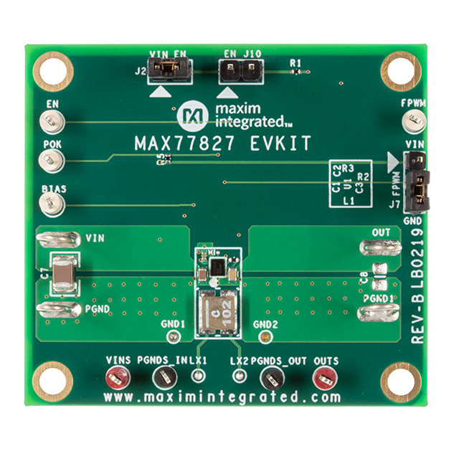
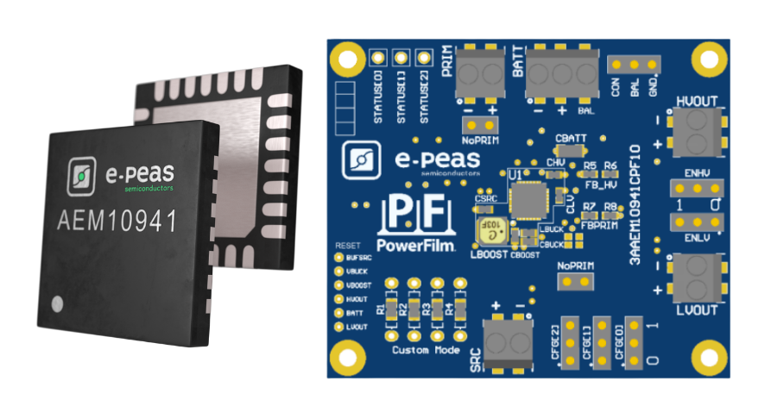
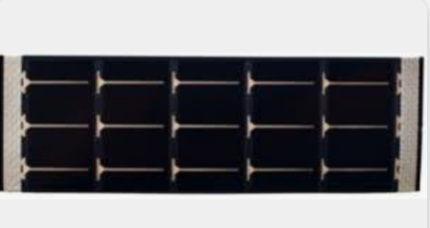
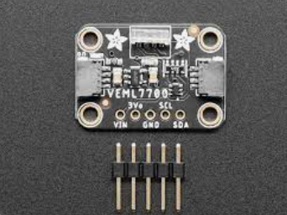
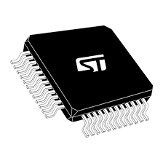

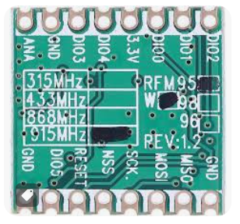
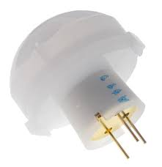
Solar cell
Buck-Boost Regulator (MAX77827)
AEM10941 PMIC Micro Controller
Light Sensor-VEML7700
MCU-STM32L010C6
RFM-95 Wireless Module
Super Capacitor
PIR Sensor

Slide 12
Challenges:
Energy Harvesting Efficiency: Consistent and efficient energy harvesting is challenging, especially in adverse weather or low-light conditions.
Supercapacitor Charging Time: Managing charging time, especially at night, is crucial for continuous operation and storage optimization.
Hardware Reliability: Robust hardware mechanisms are needed to maintain reliability and prevent failures, particularly for outdoor applications with high energy consumption during nighttime.

Slide 13
Advantages and Disadvantages:
Advantages:
Energy Autonomy: Uses a supercapacitor for energy storage, reducing environmental impact.
Real-Time Operation: Adjusts illuminance levels based on movement detection for efficient energy use.
LoRaWAN Communication: Enables long-range communication for remote monitoring and control.
Disadvantages:
Initial Setup Costs: Higher costs due to advanced technologies may hinder widespread adoption.
Energy Harvesting Limitations: Efficiency challenges during adverse weather or in low-light areas.
Complexity in Energy Management: Requires sophisticated algorithms for optimal performance.

Slide 14
CONCLUSION & FUTURE SCOPE:
The bSlight system presents a groundbreaking solution for energy-efficient street light management, utilizing innovative technologies like supercapacitors, solar energy harvesting, and LoRaWAN communication to optimize energy consumption and enhance safety in urban environments.
Future Scope:
Scalability: Enhancements can be made to scale the system for larger urban deployments, ensuring seamless integration with existing infrastructure.
AI Integration: Future developments could involve integrating advanced AI algorithms for predictive maintenance, further optimizing energy usage and operational efficiency.
Enhanced Monitoring: Implementing real-time monitoring features to track system performance, detect faults, and improve overall reliability for long-term sustainability.

Slide 15
REFERENCES
P. Mohanty, U. C. Pati, K. Mahapatra and S. P. Mohanty, "bSlight: Battery-Less Energy Autonomous Street Light Management System for Smart City," in IEEE Transactions on Sustainable Computing,vol.9,no.1,pp.100-114, Jan.-Feb. 2024, doi: 10.1109/TSUSC.2023.3310884.
S. M. Sorif, D. Saha, and P. Dutta, "Smart Street Light Management System with Automatic Brightness Adjustment Using Bolt IoT Platform," in 2021 IEEE International IOT, Electronics andMechatronicsConference(IEMTRONICS),Toronto,ON,Canada,2021,pp.16,doi:10.1109/IEMTRONICS52119.2021.9422668.
P. Mohanty, U. C. Pati and K. Mahapatra, "Self-Powered Intelligent Street Light Management System for Smart City," 2021 IEEE 18th India Council International Conference (INDICON), Guwahati, India, 2021, pp. 1-6, doi: 10.1109/INDICON52576.2021.9691575.

Slide 16
THANK YOU

